Slide 1
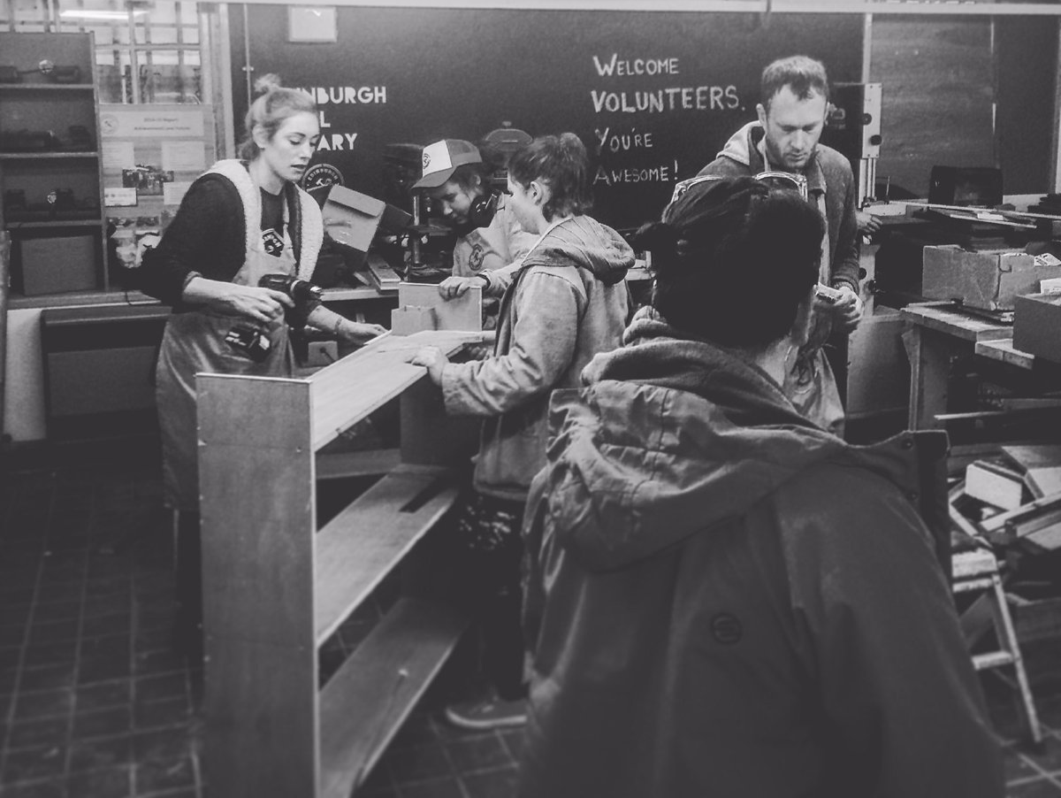
Edinburgh Tool Library:
The Forks Awaken
Chris Hellawell

Slide 2
Notes:
Explain what a tool library is – and how it works. 13 minutes.

Slide 3
Long ago in a galaxy not so far away...
Notes:
ETL’s origin story. Canada – about more than tools.
Keep it brief.

Slide 4
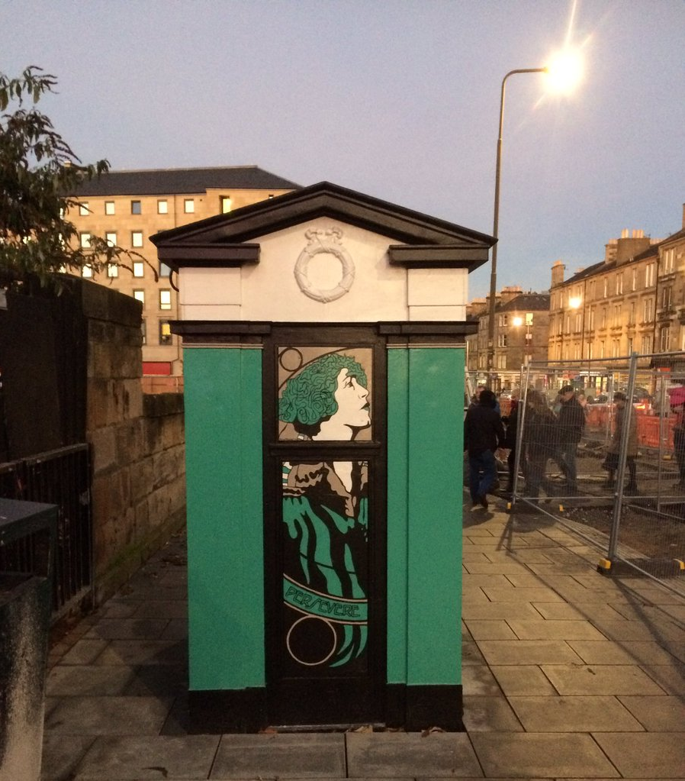
Leith Walk Police box

Slide 5
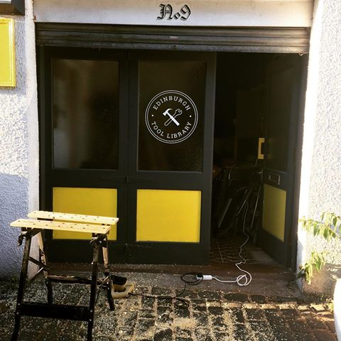
Spey Street Depot

Slide 6
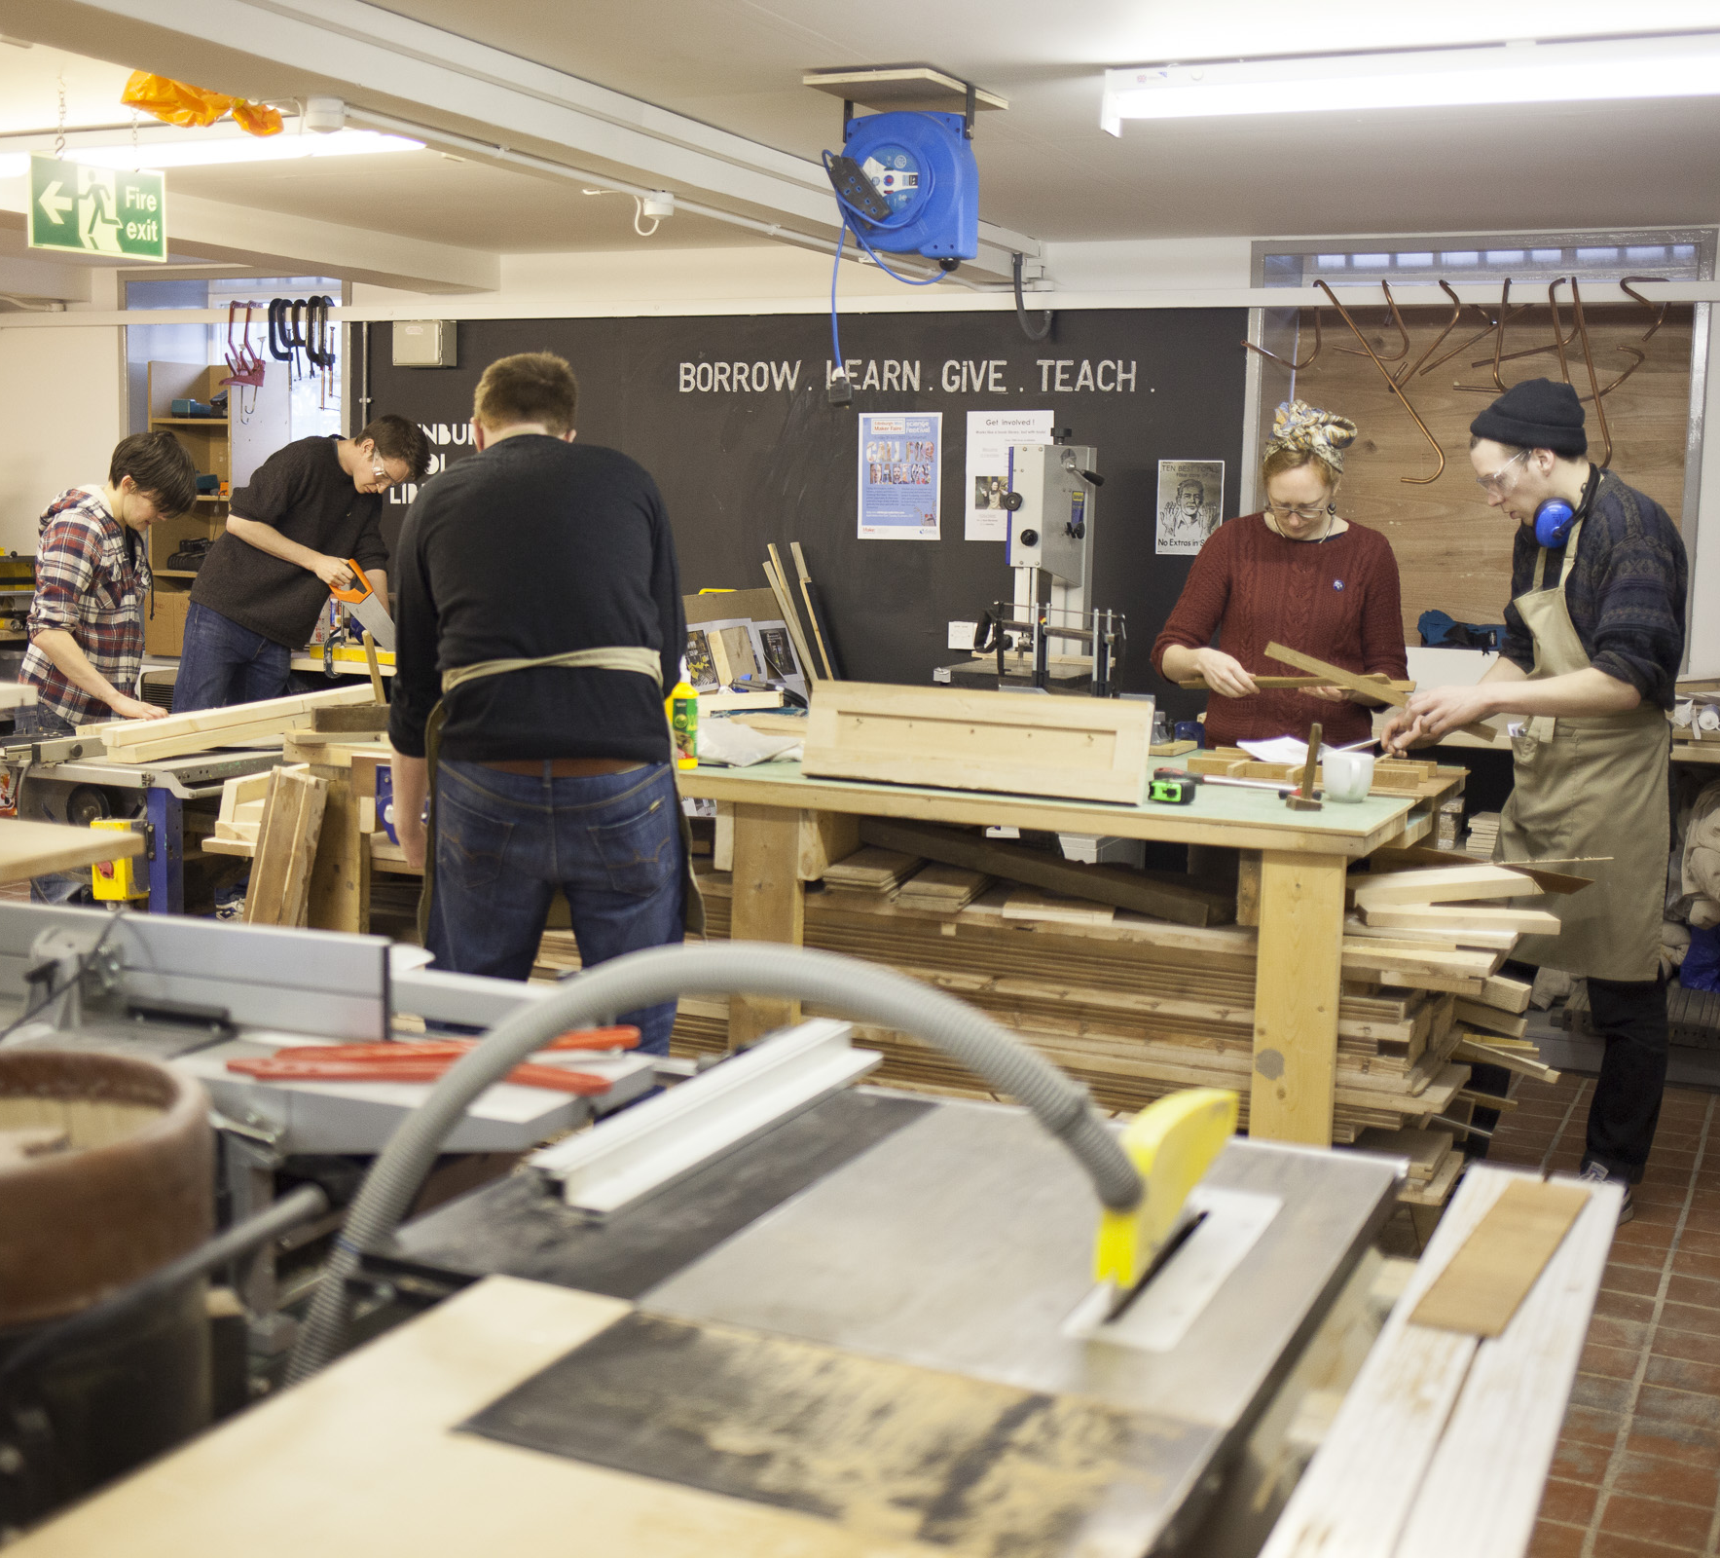
Custom Lane
Notes:
Your third session here
Workshop
Sat 2pm - 5pm
Plus another evening weekday
NO Pick-up/Drop-off session
Welcoming members
Keeping the space tidy
Keep an eye on the safety side of things with Mo and other members of staff
So before any volunteering session at the workshop you need to pass the INDUCTION

Slide 7
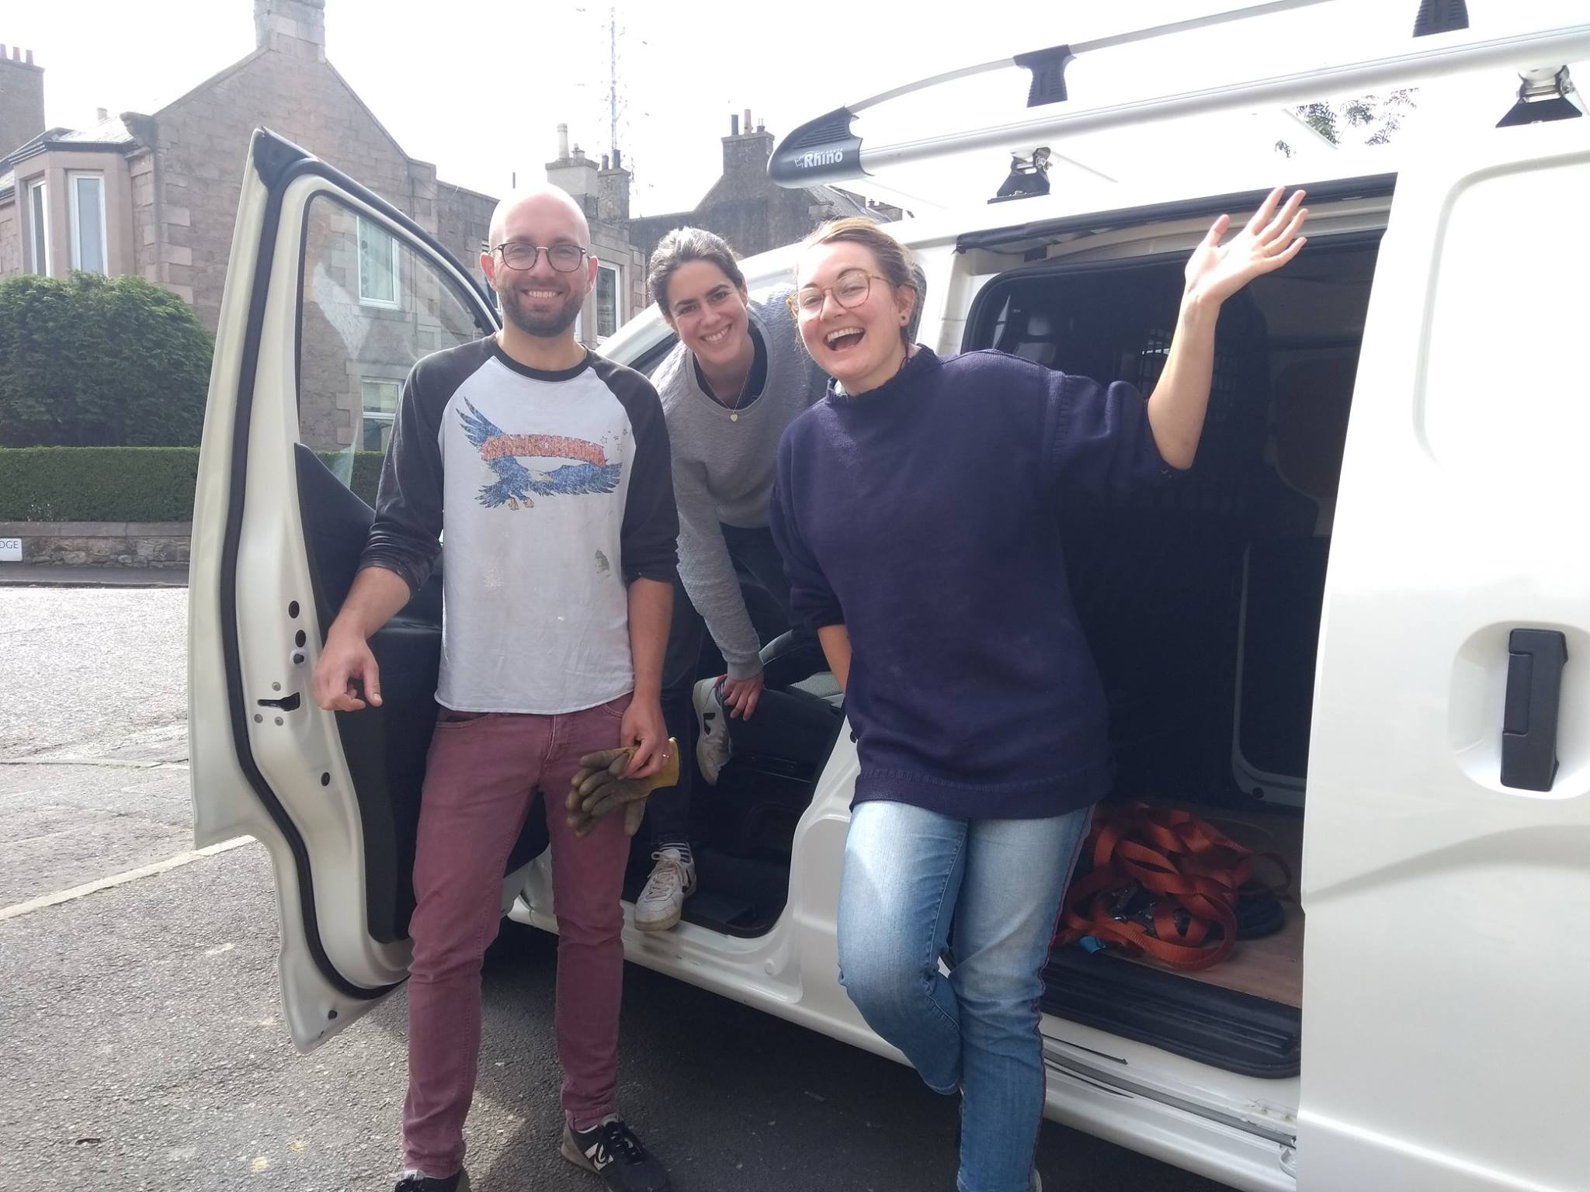
ETL in Porty
Notes:
Eddie Van Haulin – allowing us to deliver workshops and tools across the city.

Slide 8
Notes:
ETL programmes – Fork in the Road, Volunteer Assemblies, Tools For Life, Young Tooligans, Workshop programmes (CCF and Women’s Woodshop)
What are our motivations – building a cohesive community

Slide 9
Sharing Economy: A New Hope
Notes:
When people talk about the sharing economy – Air BNB, Uber – monetising things you own, like your car and your home.
a
REAL sharing economy is about recognising that through sharing the collective are all richer. Access over Excess.

Slide 10
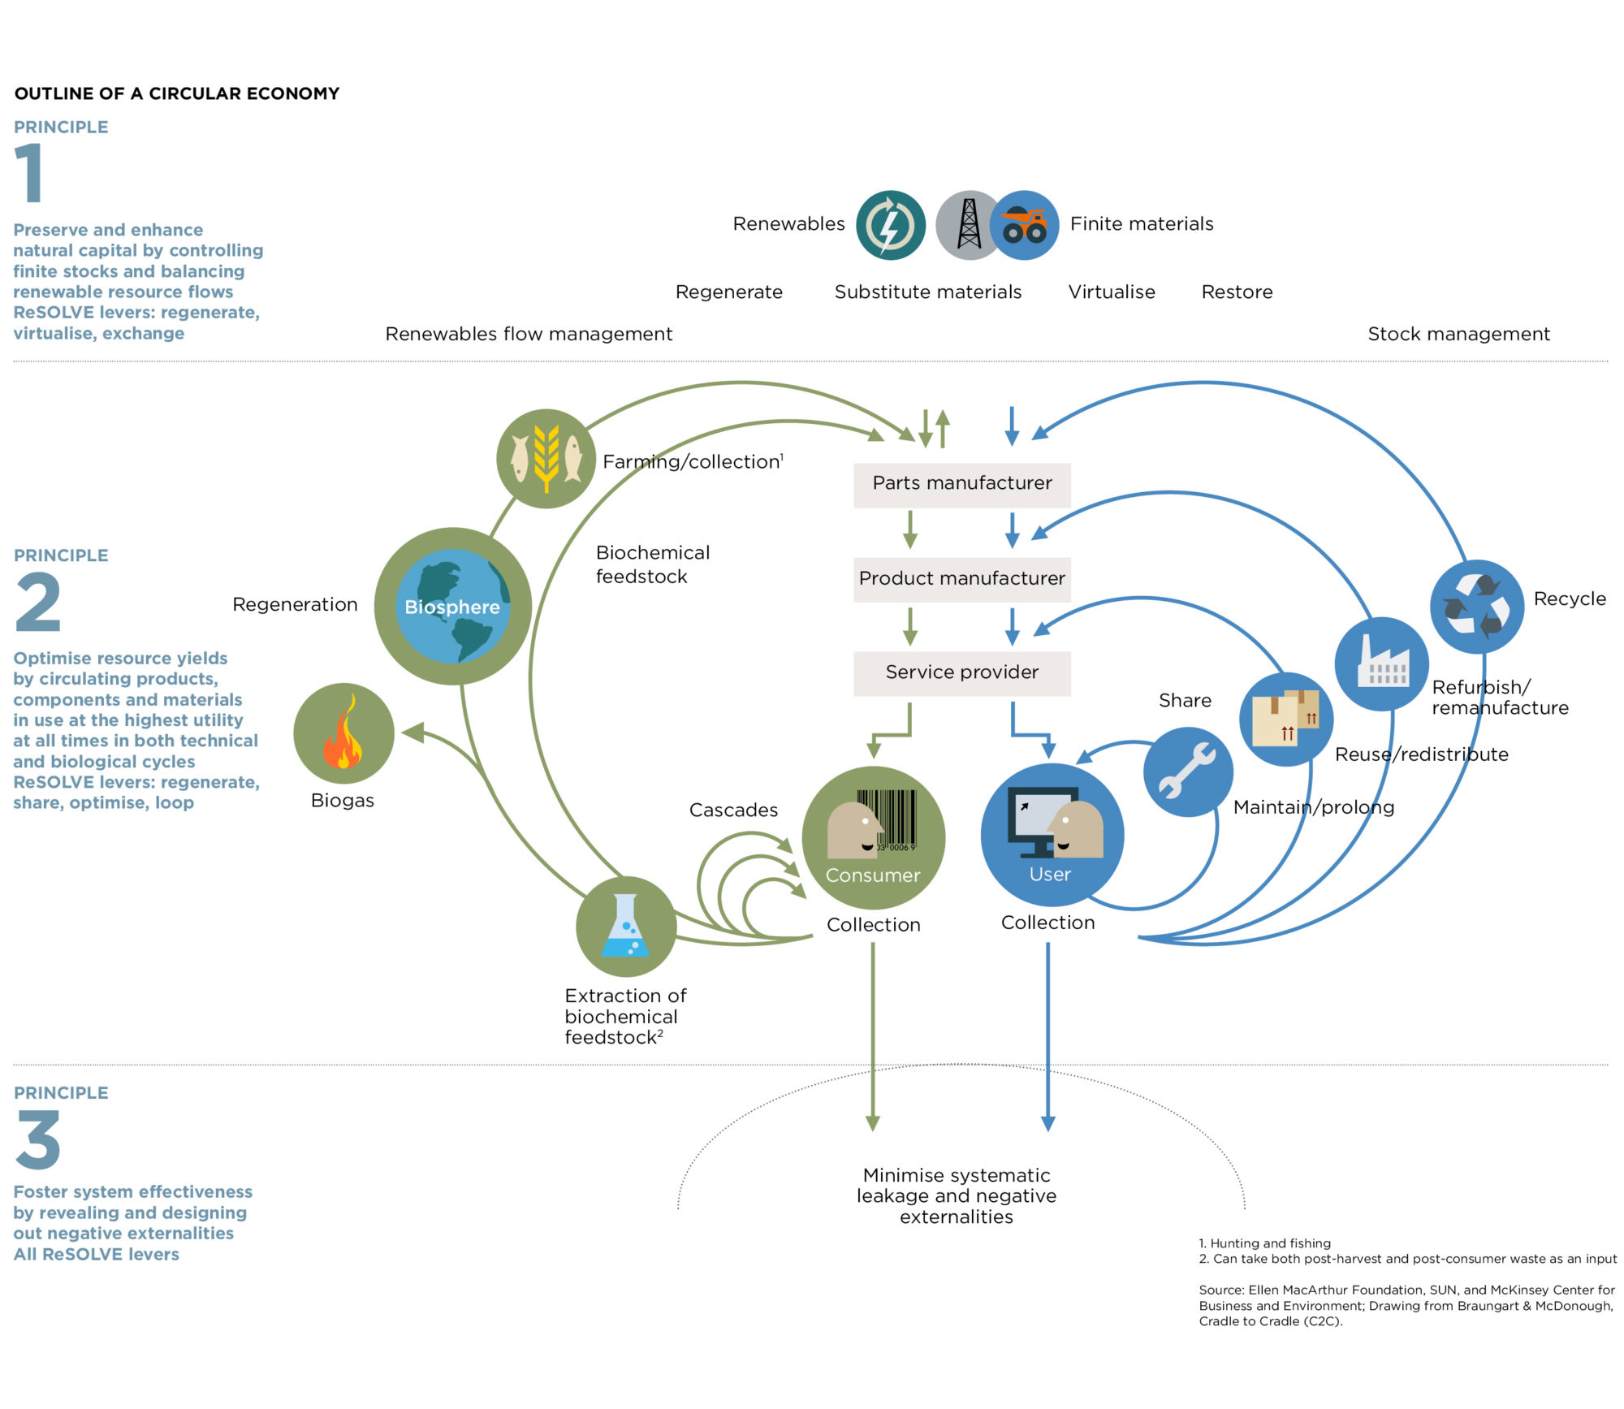
Circular Economy Butterfly
Notes:
Connecting the sharing economy to the circular economy – how do we make ownership circular as opposed to linear? Our tools wear out. We are not truly circular, we just have a longer line. How are we trying to make tool libraries more circular? Producer responsibility is key – Built to Last campaign – tools can be made to be repaired – talk about B&Q router.

Slide 11
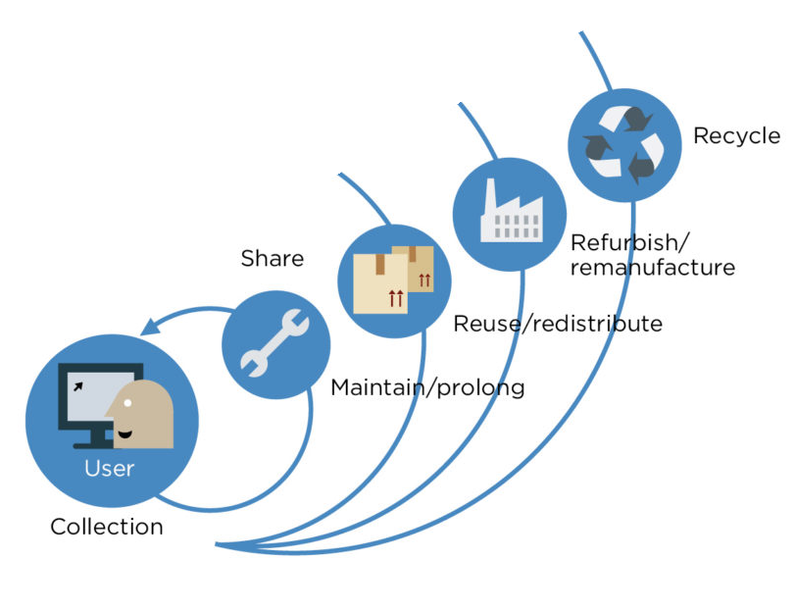
Sharing = Resource Efficiency

Slide 12
Edinburgh Tool Library wants to make:
Sharing Simpler than Shopping
Borrowing Easier than Buying
How can we scale Sharing?

Slide 13
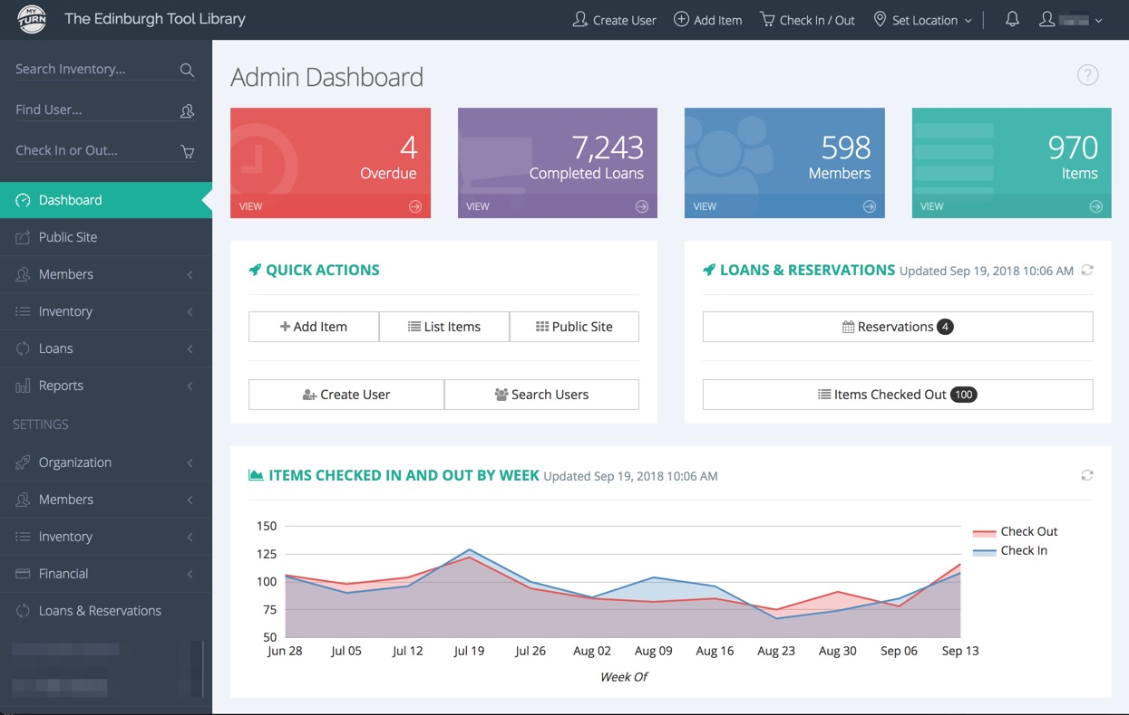
EasyShare/Easy Sharing
Notes:
ETL generates data. I can tell you that one drill has been borrowed by 97 different people over 2.5 years. If all those people had bought a drill they would have spent £8500, and made a carbon footprint of approximately 2.5 tons of carbon. Collectively our members have saved over £450,000. In terms of EasyShare, the platform will develop a sort of Freegle/Gumtree mapping capability, add in things that can be shared (tools, toys, baby slings) and volunteer opportunities, skill sharing at the front end (user interface) generating data for the back end. So for example, a sofa that someone doesn’t need is currently picked up by the council. If shared on EasyShare, the interface can work out logistics of moving the sofa across the city using journeys already being made, drop at a central point in another community, where it is picked up by it’s new owner. The carbon savings this reuse of the sofa makes can then be recorded by the system, and reported to the city council.

Slide 14
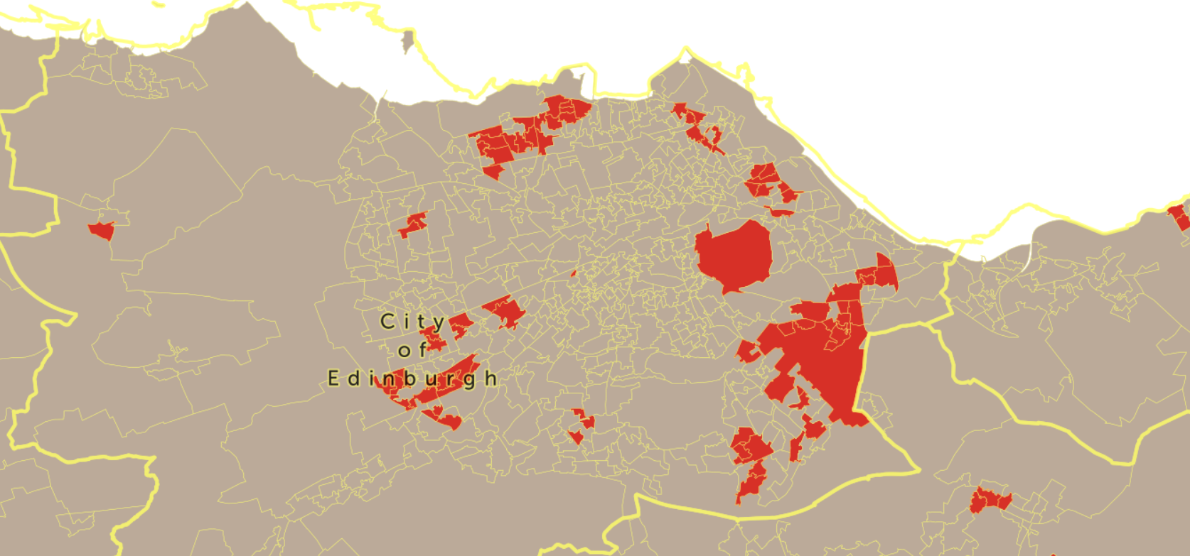
Areas of Multiple Deprivation
Granton
Muirhouse
Broomhouse
Wester Hailes
Notes:
Why are the best second hand shops in Edinburgh in Morningside and Stockbridge? They would serve the city better if the good quality clothes not needed by these affluent citizens were moved to areas where they would be of most benefit. Equally, we have worked in Leith and Portobello, which have mixed socio-economic communities. With EasyShare we are experimenting with taking the service into some of the areas of multiple deprivation in the city. Often people are excluded from the advantages of sharing because of a lack of digital literacy, internet access, or transport. By partnering with community projects already tapped in to these areas we are hoping to reach people we have struggled to find previously. Mobile libaray, with a predefined route. Like an ice cream van.

Slide 15
Future of Sharing in Scotland
Everyone has access to a sharing library
Workshops are shared between groups as community facilities
EasyShare rolled out across Scotland
Centrally funded by the Scottish Government
Inter-library loans
Shared access to equipment in new build estates and apartment blocks – use of technology
Producer responsibility – Make Things Last
Notes:
Tool libraries generate data, and could be valuable real world testing areas for manufacturers. Manufacturers should be pushed towards service models, rather than ownership ones. This would drive better made, modular pieces of equipment that are made to last, but also made to be repaired. This would stimulate jobs in the engineering and remanufacture sector.

Slide 16
Future of Sharing in Scotland
Sharing is no longer just for kids
Sharing becomes the norm
Sharing becomes simpler than shopping

Slide 17
The Bounce-back Effect
How could we monitor it?
What would we do with the results?
Should we monitor it?
How far do we follow the rabbit hole?
Notes:
Ethics of data that we monitor. If someone saved £100 on a drill and can then afford to visit their granny in London by taking a flight they would otherwise not have been able to take, is that a good thing?

Slide 18
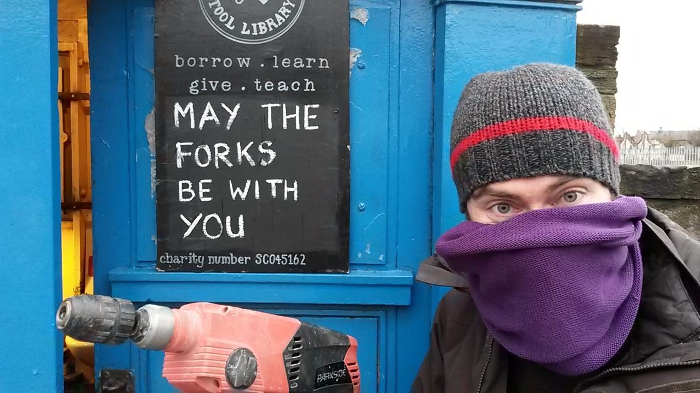
Thank you and…

Slide 19
@edinburghtoollibrary
@edintoollibrary
@ETLChris‬
@edinburghtoollibrary

