Slide 1
DATA, DESIGN & THE CITY
JAMES STEWART & MORGAN CURRIE
25 JANUARY 2019

Slide 2
announcements
Notes:
James at Transition Edinburgh, Sampsa’s remarks, Anton’s presentation is an example of a pitch. http://www.socialpolicy.ed.ac.uk/events/seminar_series/2018_2019/influencing_politics_and_business_the_greenpeace_way._a_practitioners_view

Slide 3
Fieldwork preparation

Slide 4
schedule
Reflective exercise
Examples of design projects:
Speculative & critical design
Designing for the circular economy
What is data?
Data exercise
4. Team brainstorming
5. Garbology assignment

Slide 5
Just writing
(5 minutes)

Slide 6
Today’s prompts
Which do I prefer: talking or listening?
What makes a team work well?
Can you think of some team projects in your past? What made them successful, or not?

Slide 7
Some theories on how design can help
Notes:
-design is a form of governance – it shapes and regulars behavior, interactions, and conversations

Slide 8
speculative design
“[Speculative design] thrives on imagination and aims to open up new perspectives on what are sometimes called wicked problems, to create spaces for discussion and debate about alternative ways of being, and to inspire and encourage people’s imaginations to flow freely.
-Speculative Everything: Design, Fiction, and Social Thinking, Dunne & Raby, 2013 p. 2
“We posit future scenarios (typically phrased as What if? questions), entertain their consequences and exigencies, and share the results widely, to enable public conversations and debate.”
-The City of Tomorrow, Ratti & Claudel, 2016, p. 5

Slide 9
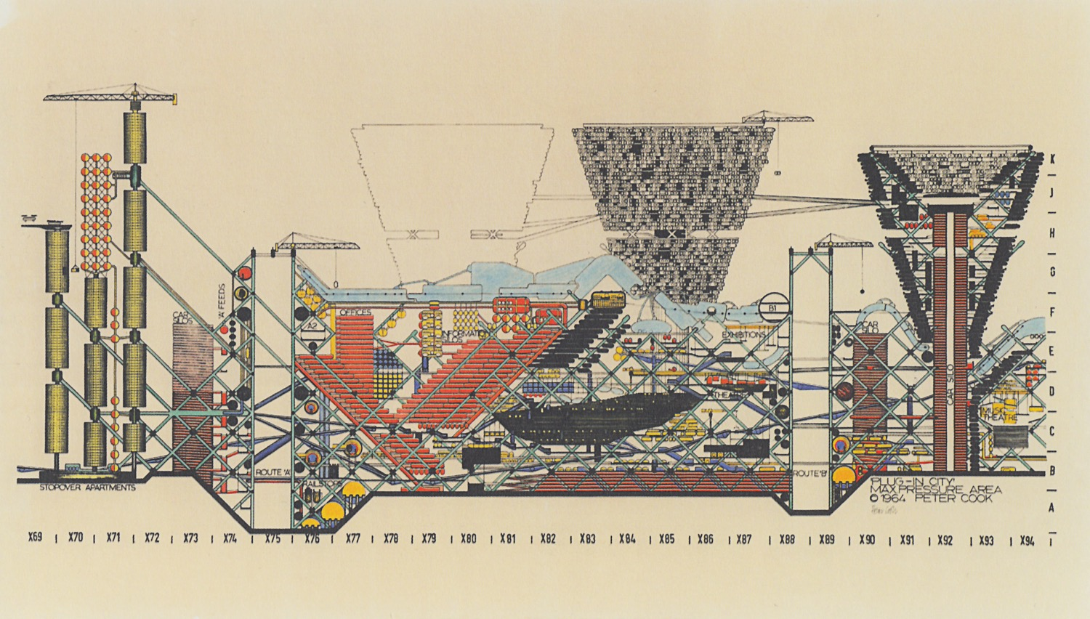
Archigram
Plug-in City

Slide 10
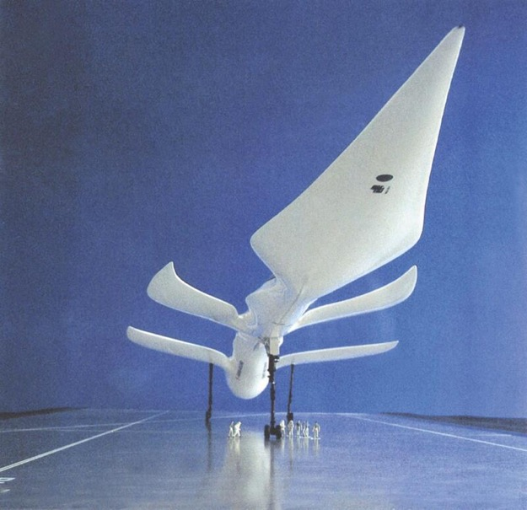
Luigi colani
Aerodynamic aircraft, 1970s

Slide 11
Yes men
Fake NYT, 2009

Slide 12
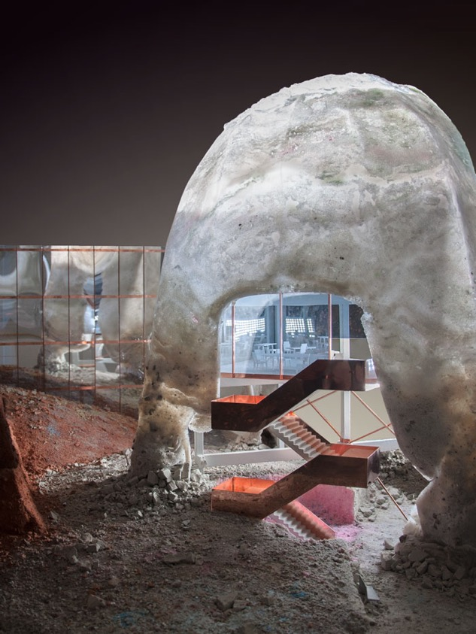
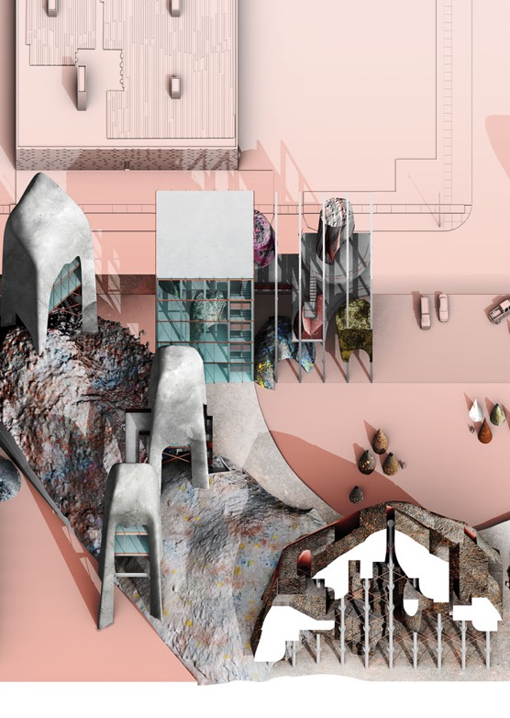
T.E.A.M
Detroit Reassembly Plant, 2016

Slide 13
speculative design
Not a predictive tool
but a discursive, critical, pluralistic, participatory tool
unconcerned with market forces and constraints
using public conversation and debate
to help us see past current limitations and imagine a more desired future
Notes:
Critical: a good critical design offers alternatives to how things are now. Also a way to be a critical consumer – to raise awareness of our power as a consumer.

Slide 14
anticipatory design science
“The function of what I call design science is to solve problems by introducing into the environment new artifacts, the availability of which will induce their spontaneous employment by humans and thus, coincidentally, cause humans to abandon their previous problem-solving behaviors and devices.”
-Buckminster Fuller and Kiyoshi Kuroiya, Cosmography: A Posthumous Scenario for the Future of Humanity 1992, p. 8

Slide 15
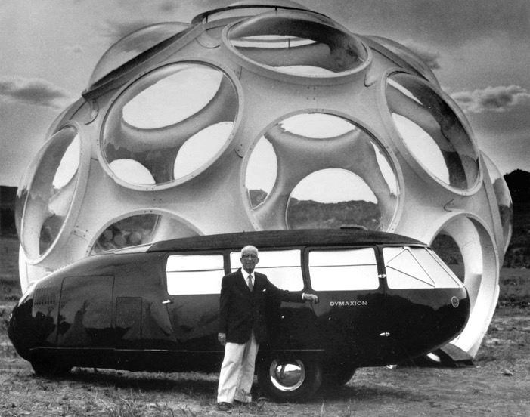
Buckminster fuller
Montreal Biosphere, 1967
Dymaxion car, 1930s
Notes:
Created term ‘synergy’, Ephemeralization which meant “doing more with less”. Synergetics uses physics and geometry to describe parts of a system in relation to the whole, how they change and work together.

Slide 16
Luigi colani
Aerodynamic truck, 1970s

Slide 17
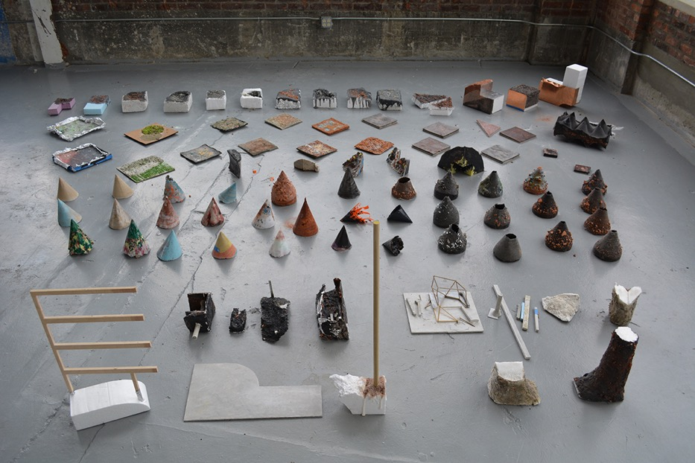
Meredith miller & thom moran
Post Rock, ongoing

Slide 18
designing for a circular economy

Slide 19
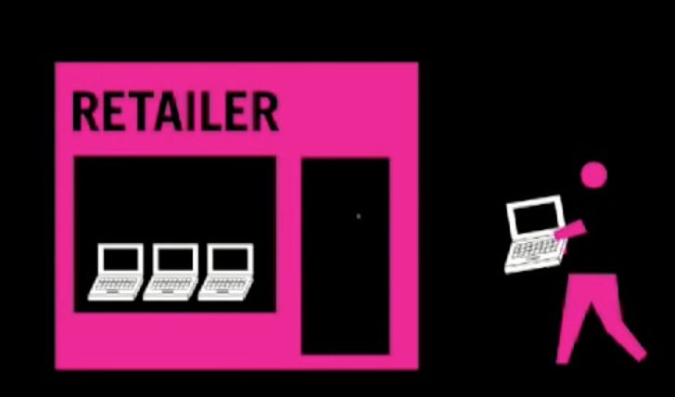
Raising consumer Awareness:
GOOD Magazine, E-waste video, 2007

Slide 20
Raising political Awareness:
Greenpeace

Slide 21
Social movement organising
Notes:
Example of making waste visible through data
Infrastructure legibility
relying on existing infrastructure, technologies, and data to collect traces. What were the limitations they found?
Cleaning data and messiness of data (where the trace came from may not be where the item actually is.
This project is, in a way, speculative design: it is critical, a civic forum for discussion, and a campaign for a different, better future

Slide 22
Making waste visible
Trash Track, MIT, 2009-2010
Notes:
Example of making waste visible through data
Infrastructure legibility
relying on existing infrastructure, technologies, and data to collect traces. What were the limitations they found?
Cleaning data and messiness of data (where the trace came from may not be where the item actually is.
This project is, in a way, speculative design: it is critical, a civic forum for discussion, and a campaign for a different, better future

Slide 23
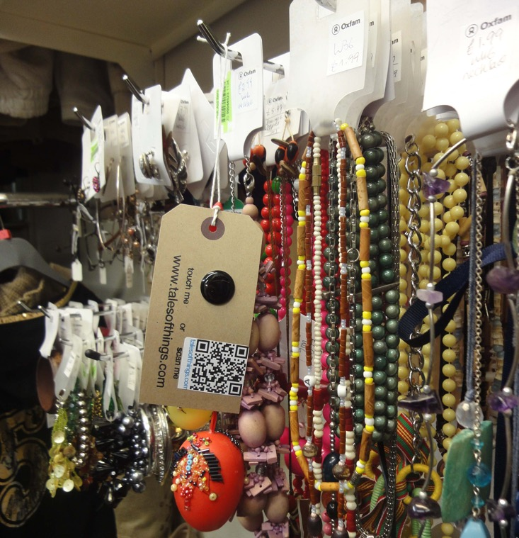
Making the C.E. visible:
TOTeM, UofE, 2010
Notes:
Example of making waste visible through data
Infrastructure legibility
relying on existing infrastructure, technologies, and data to collect traces. What were the limitations they found?
Cleaning data and messiness of data (where the trace came from may not be where the item actually is.
This project is, in a way, speculative design: it is critical, a civic forum for discussion, and a campaign for a different, better future

Slide 24
imagining new supply chains
Shoey Shoes, Thomas Leech, 2017
Notes:
Example of making waste visible through data
Infrastructure legibility
relying on existing infrastructure, technologies, and data to collect traces. What were the limitations they found?
Cleaning data and messiness of data (where the trace came from may not be where the item actually is.
This project is, in a way, speculative design: it is critical, a civic forum for discussion, and a campaign for a different, better future

Slide 25
imagining new supply chains
Precious Plastics
Notes:
Example of making waste visible through data
Infrastructure legibility
relying on existing infrastructure, technologies, and data to collect traces. What were the limitations they found?
Cleaning data and messiness of data (where the trace came from may not be where the item actually is.
This project is, in a way, speculative design: it is critical, a civic forum for discussion, and a campaign for a different, better future

Slide 26
Enabling new consumer choice
mCycle, Kaye Toland, 2017
Notes:
Example of making waste visible through data
Infrastructure legibility
relying on existing infrastructure, technologies, and data to collect traces. What were the limitations they found?
Cleaning data and messiness of data (where the trace came from may not be where the item actually is.
This project is, in a way, speculative design: it is critical, a civic forum for discussion, and a campaign for a different, better future

Slide 27
mCycle, Kaye Toland, 2017
Notes:
Example of making waste visible through data
Infrastructure legibility
relying on existing infrastructure, technologies, and data to collect traces. What were the limitations they found?
Cleaning data and messiness of data (where the trace came from may not be where the item actually is.
This project is, in a way, speculative design: it is critical, a civic forum for discussion, and a campaign for a different, better future

Slide 28
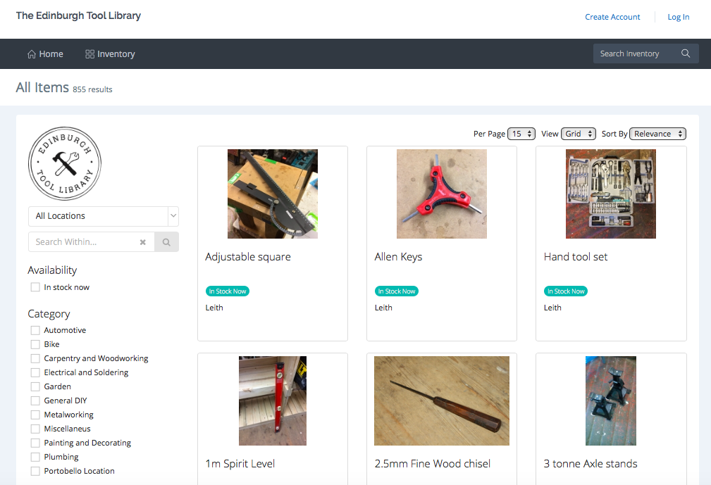
Enabling the sharing economy
MyTurn
Notes:
Example of making waste visible through data
Infrastructure legibility
relying on existing infrastructure, technologies, and data to collect traces. What were the limitations they found?
Cleaning data and messiness of data (where the trace came from may not be where the item actually is.
This project is, in a way, speculative design: it is critical, a civic forum for discussion, and a campaign for a different, better future

Slide 29
Modes of intervention happen at different scales
Provoking the individual as a consumer
Addressing the individual as a political actor
Sparking community discussion and involvement
Enabling new behaviours at local and national scales
Contributing to social movements towards political change and structural, legal reform
Notes:
Example of making waste visible through data
Infrastructure legibility
relying on existing infrastructure, technologies, and data to collect traces. What were the limitations they found?
Cleaning data and messiness of data (where the trace came from may not be where the item actually is.
This project is, in a way, speculative design: it is critical, a civic forum for discussion, and a campaign for a different, better future

Slide 30
What is data?
Notes:
Data and waste. Lack of data can add to lack of accountability – knowing the systems are working, that companies aren’t greenwashing or flouting the law. Lack of reliable data can also undermine policy
Waste is counted as such based on its classification as waste. How might it be classified differently?
What is waste in the circular economy, then? Rather than an output, it is an input

Slide 31
What is data?
Datum: “some difference or lack of uniformity within some context” – Floridi, 2017
Data: “a set of systematic observations that have been symbolically encoded and stored in material form” – Offenhuber, 2017, p. 7
Data: “an interpretation of the phenomenal world, not inherent in it.” – Drucker, 2011
A political tool?
Notes:
Data and waste. Lack of data can add to lack of accountability – knowing the systems are working, that companies aren’t greenwashing or flouting the law. Lack of reliable data can also undermine policy
Waste is counted as such based on its classification as waste. How might it be classified differently?
What is waste in the circular economy, then? Rather than an output, it is an input

Slide 32
What is data?
Requires a method of observation and collection
A symbolic system to represent it (taxonomy)
A method to encode the observation into symbols
Storage in physical form
Notes:
Data and waste. Lack of data can add to lack of accountability – knowing the systems are working, that companies aren’t greenwashing or flouting the law. Lack of reliable data can also undermine policy
Waste is counted as such based on its classification as waste. How might it be classified differently?
What is waste in the circular economy, then? Rather than an output, it is an input

Slide 33
Team exercise
Each person has 5 mins to talk to two other people not in their team:
What data can you find out about waste & recycling in Edinburgh from the person you are talking to?
You’ll need to phrase your question appropriately
Record your findings
Share results with other members of the team
Each team feeds back answer to “What is data?” to whole class

Slide 34
Garbology assignment

Slide 35
Any closing issues, general questions

