Slide 1
DATA, DESIGN & THE CITY
JAMES STEWART & MORGAN CURRIE
8 MARCH 2019

Slide 2
Just writing
(5 min.)

Slide 3
timeline
Introduction to Data visualisations
6 myths of data visualisations
Exercise: find examples to illustrate the 6 myths
Data vis software tutorials
Team break-outs: make visualisations with your own datasets and share with the class
Notes:
Event this Thursday: https://www.eventbrite.co.uk/e/zero-carbon-scotland-what-must-we-do-and-how-quickly-can-we-do-it-justly-tickets-56577964214
NYT article: https://www.nytimes.com/2019/02/16/style/plastic-how-to-use-less.html

Slide 4
Data visualisation
Information visualizations are used to make quantitative data legible. They are particularly useful for large amounts of information and for making patterns in the data legible in a condensed form.
Notes:
http://dh101.humanities.ucla.edu/?page_id=40

Slide 5
Data visualisation
Compare these two images:
Notes:
But not all data are ‘facts’ – some might be untrue. Facts, actually, often come from data
Informational – all about the ability to process something, whether or not it’s factual. But this also poses difficulty because we think of information as arising from data. Also, some data don’t contain information about anything, such as data on a CD or DVD.
Computational – reduced to material support
Diaphoric – a signal that can be interpreted

Slide 6
Compare these two images:
Notes:
But not all data are ‘facts’ – some might be untrue. Facts, actually, often come from data
Informational – all about the ability to process something, whether or not it’s factual. But this also poses difficulty because we think of information as arising from data. Also, some data don’t contain information about anything, such as data on a CD or DVD.
Computational – reduced to material support
Diaphoric – a signal that can be interpreted

Slide 7
Compare these two images:
Fig.3: Edinburgh-based political economist and one of the inventors of graphical design William Playfair (1759-1823) famous chart where he compares 'in one view' price of wheat and wages.

Slide 8
Data visualisations
Visualizations have a strong rhetorical force by virtue of their graphic qualities, and can easily distort the data/capta. All visualizations are interpretations, and data have no inherent visual form. But only some forms are more suited to the structure of a given data set than others.
Notes:
http://dh101.humanities.ucla.edu/?page_id=40

Slide 9
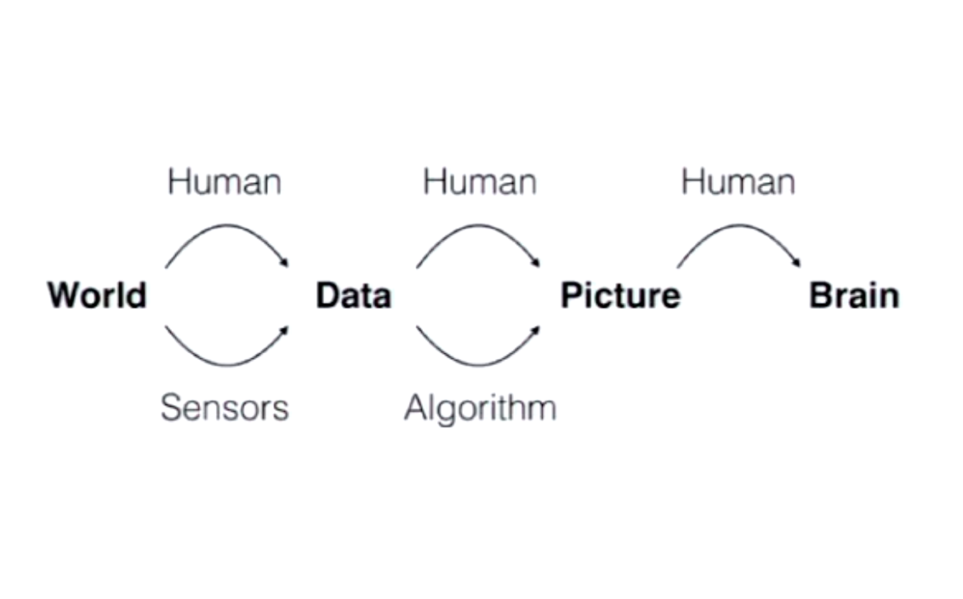
Benjamin bach’s diagram of an info vis
Notes:
Start from the world, something gives us data from the world (human or sensors), can introduce bias into the data. Maybe not whole data, noisy data. From the data we make a visualisation, either through a human or an algorithm. Human can introduce bias in how they make the visualisation, same with algorithm. It may not be able to deal with complexity of a dataset. The picture wants to go into our brain.

Slide 10
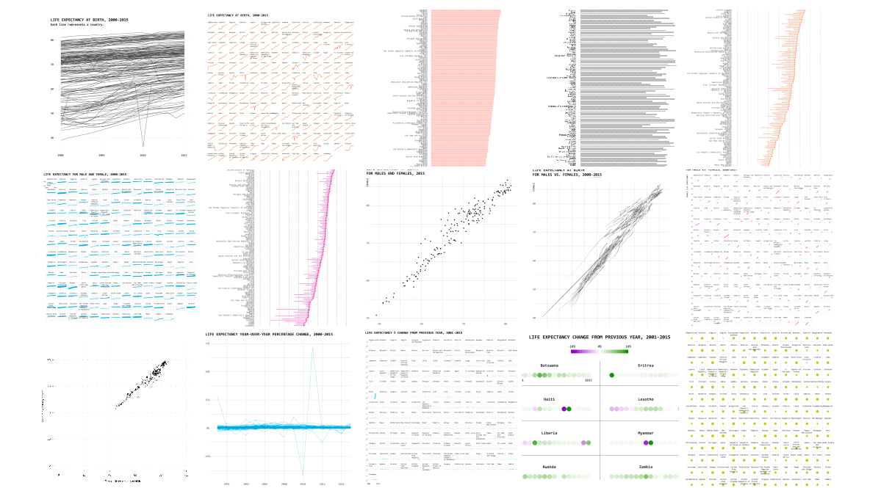
1 dataset visualised 25 ways
Notes:
This link illustrates how selecting a form for data is an act of interpretation.
Different ways of representing data changes the way we might interpret it: https://flowingdata.com/2017/01/24/one-dataset-visualized-25-ways/#jp-carousel-47350
Process of understanding data is interactive process on many levels. Through dynamism you can see multiple facets of same dataset.
Exposes facets of creating data vis:

Slide 11
Data visualisations
Some things to keep in mind:
Is data discrete or continuous?
For instance, if you are showing change over time, use a continuous graph.

Slide 12
Notes:
This has several problems. First, it’s never a good idea to illustrate elements of a chart. What does it even mean that five books is equal to 75%, or that 16 books is equal to 82%? But ultimately, this is a column chart, and column charts must always start the y-axis at zero.
A column chart is the worst possible way to show these data, even with a fixed y-axis. In chart-making, choosing the appropriate form to represent the data on hand is of utmost importance. And when you want to show subtle changes in rates over time, you use a line chart.
https://qz.com/580859/the-most-misleading-charts-of-2015-fixed/

Slide 13
Notes:
There are a few things we can get out of this larger context. One is that graduation rates were already trending upward when Barack Obama became president. Another is that, as of 2012, the percentage point increase in graduation rates was higher under Obama than any previous president. And if the 2014 graduation rate was 82%, as the White House chart shows, that increase is actually closer to seven points.
https://qz.com/580859/the-most-misleading-charts-of-2015-fixed/

Slide 14
Data visualisations
Some things to keep in mind:
The way in which you label and order your graphic elements will make some arguments more immediately evident. If you want to compare quantities, be sure they are displayed in proximity.
The use of labels is crucial and their design can either aid or hinder legibility.

Slide 15
Notes:
Charles Minard. 1812 The illustration depicts Napoleon's army departing the Polish-Russian border. A thick band illustrates the size of his army at specific geographic points during their advance and retreat. It displays six types of data in two dimensions: the number of Napoleon's troops; the distance traveled; temperature; latitude and longitude; direction of travel; and location relative to specific dates without making mention of Napoleon

Slide 16
Benjamin Bach’s 6 myths of information visualisations

Slide 17
Myth 1: Information visualisations are pretty pictures

Slide 18
Notes:
But what does it mean? Talking about where high speed trains are around the world. To make purposeful designs: data-ink ration.
https://i.pinimg.com/736x/89/a6/52/89a6520f4686347db400baaf5e2746fa.jpg

Slide 19
Notes:
From Accurate studio: https://www.accurat.it
Beautiful, but really difficult to interpret

Slide 20
Notes:
To make purposeful designs: data-ink ration. The amount of data ink on a screen, divided by total ink used to represent the graphic. Remove parts that are not data ink. Remove everything not directly related to communicating data.
20:37
https://media.ed.ac.uk/playlist/dedicated/85801351/1_hmmnt0g9/1_kplbl26a

Slide 21
Myth 2: Information visualisations are true

Slide 22
Notes:
Statements are determined by the scale set by these graph.
[from Gian Marco’s class slides]

Slide 23
Notes:
Makes it seem that abortions are up at a proportionate rate to cancer screenings going down.
https://qz.com/580859/the-most-misleading-charts-of-2015-fixed/

Slide 24
Notes:
The same data, visualized in a more accurate way. Here you see that abortion has only gone up a small percentage, and while cancer screenings are going down, cancer screenings still far surpass abortions.
https://qz.com/580859/the-most-misleading-charts-of-2015-fixed/

