Slide 2
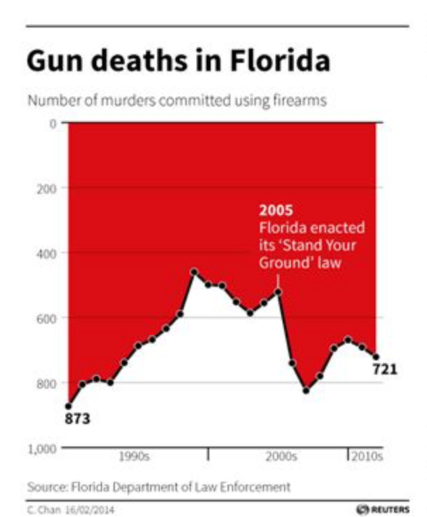
Notes:
Created by Florida Department of Law Enforcement

Slide 3
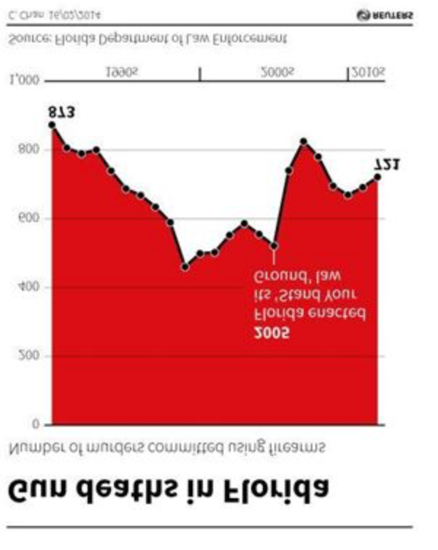

Slide 6
Myth 3: information visualisations are universal and intuitive

Slide 7
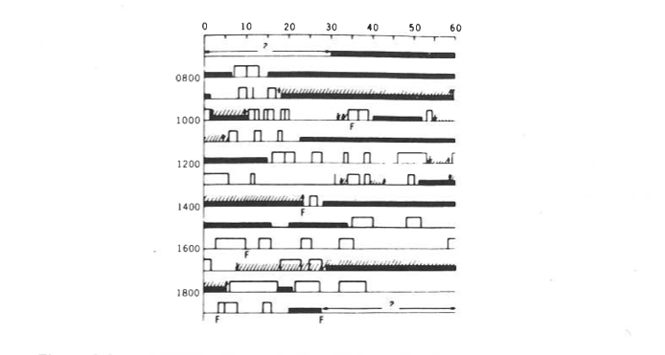
Why is this graph problematic?
The graph shows the nursing activities of a woman from an African tribe and her baby. The tall bars are nursing times. The black bars show when the baby is sleeping. F means fretting. Slashed lines are intervals when the baby is held by the mother, with arrows for picking up and setting down.
Notes:
From Gian Marco’s slides.
Problems with this:
overlap of data dimensions prevent data from standing out
arrows for picking up and setting down baby are superfluous
multiple notations require back and forth from legend.

Slide 8
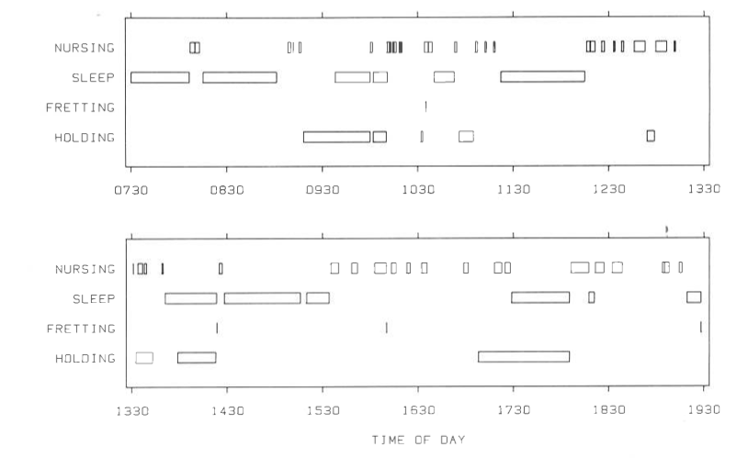
Why is this graph better?
This graph shows the same data of graph in Question 1.
Notes:
Easier to see the activity times and their interactions
Not necessary to refer to the legend every time (only one notation used)

Slide 9
The blogosphere
This graph shows the same data of graph in Question 1.
Notes:
a hyperbolic display of blogs using both the WWE and the ICWSM 2007 data sets.
A hyperbolic display contains much more space than a simple Euclidean plane because the circumference and area of the circle it's mapped upon grows exponentially with the length of its radius. The larger the circle, the greater the amount of usable space.
https://datamining.typepad.com/gallery/blog-map-gallery.html

Slide 10
Error bars
This graph shows the same data of graph in Question 1.
Notes:
Error bars can be hard for a lay person to interpret and could cause a person to infer conclusions that aren’t accurate.
When standard deviation errors bars overlap quite a bit, it's a clue that the difference is not statistically significant. You must actually perform a statistical test to draw a conclusion.

Slide 11
Myth 4: information visualisations are easy to create
Notes:
It’s hard to try to find a visual structure that showcases the data as accurately and clearly as possible.

Slide 12
Notes:
Map showing electoral area shaded by share of vote for remaining in/leaving European. This shows that some representations do a better job of conveying the underlying data

Slide 13
Notes:
Accurat studio. The images are supposed to show at what point in a writers’ life he wrote his ‘masterpiece’. Simple timelines would have done a better job to convey the information

Slide 14
Myth 5: information visualisations are static
Notes:
Static graphics are only the tip of the iceberg, a particular view.

Slide 15
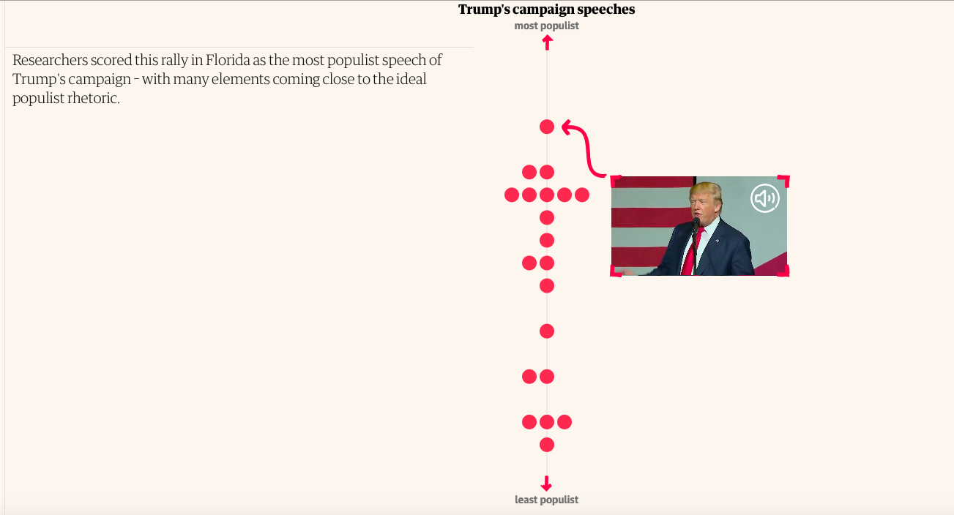
Online info graphics
Notes:
https://www.theguardian.com/world/ng-interactive/2019/mar/07/the-teleprompter-test-why-trumps-populism-is-often-scripted?CMP=Share_AndroidApp_Nine_Email

Slide 16
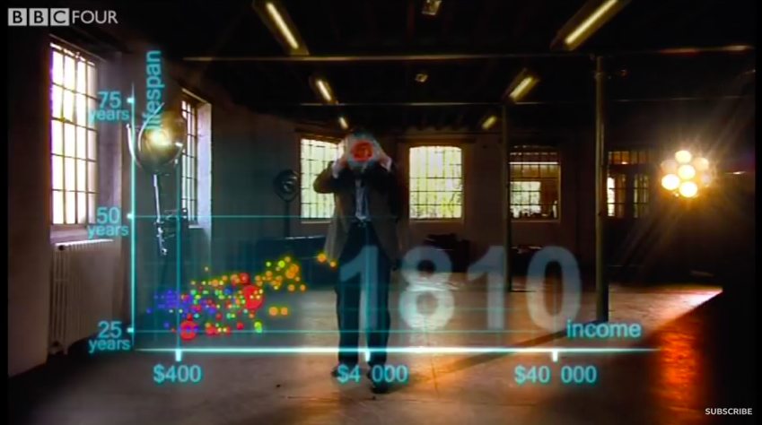
Hans rosling
Notes:
https://www.youtube.com/watch?v=jbkSRLYSojo (could watch a clip. Start at :30)

Slide 17
Myth 6: information visualisations are infographics

Slide 18
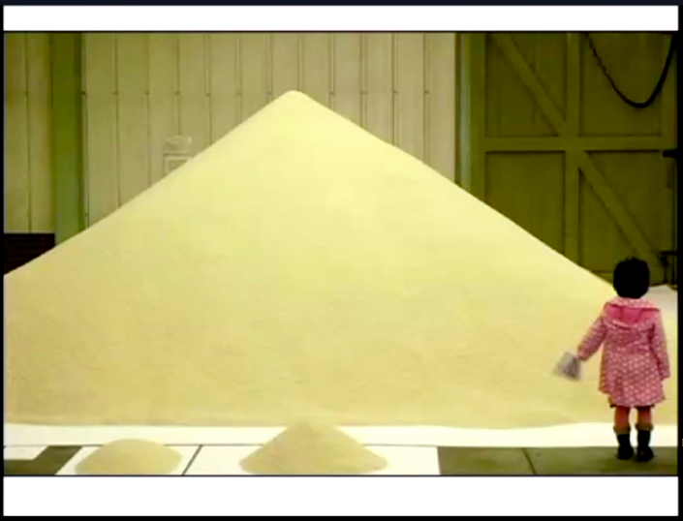
Notes:
Here, using sand to represent population (from Ben’s video)

Slide 19
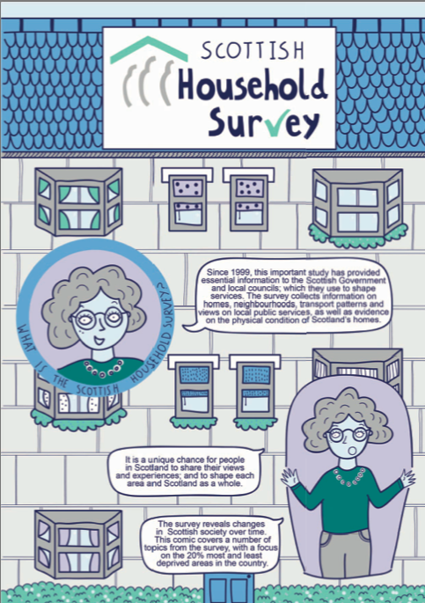
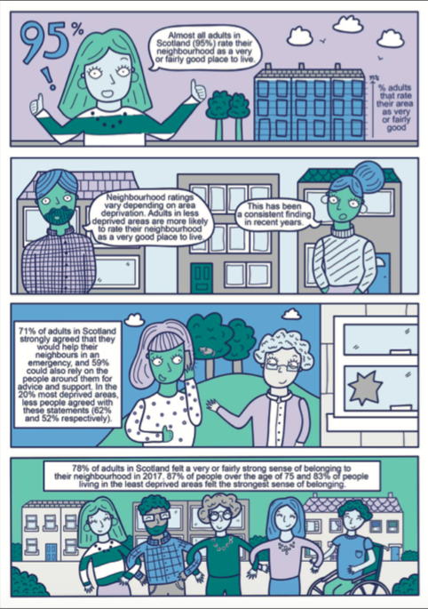
Notes:
Information visualized in comic form: https://www2.gov.scot/Publications/2018/11/6264/downloads

Slide 20
Visualisation exercise:
Find 2-3 data visualisations that illustrate one or more the 6 myths
Notes:
Smart meter data in LA is owned by a company. Smart bin data in Edinburgh is owned by a company

Slide 21
visualisation web services
RAW: http://app.rawgraphs.io
Datawrapper: https://app.datawrapper.de
Google fusion tables: https://fusiontables.google.com

Slide 22
Group exercise:
Taking your datasets, use
Look for sources from government, academic papers, non-profit sector
Notes:
http://app.rawgraphs.io
https://app.datawrapper.de
https://support.google.com/fusiontables/answer/2571232

